Slide 1
Direct democracy VS Deliberative democracy
Read more @哲學新媒體 Philosophy Medium:
直接民主 VS 审议民主
Zhu Menghang, 2023104094, political philosophy

Slide 2
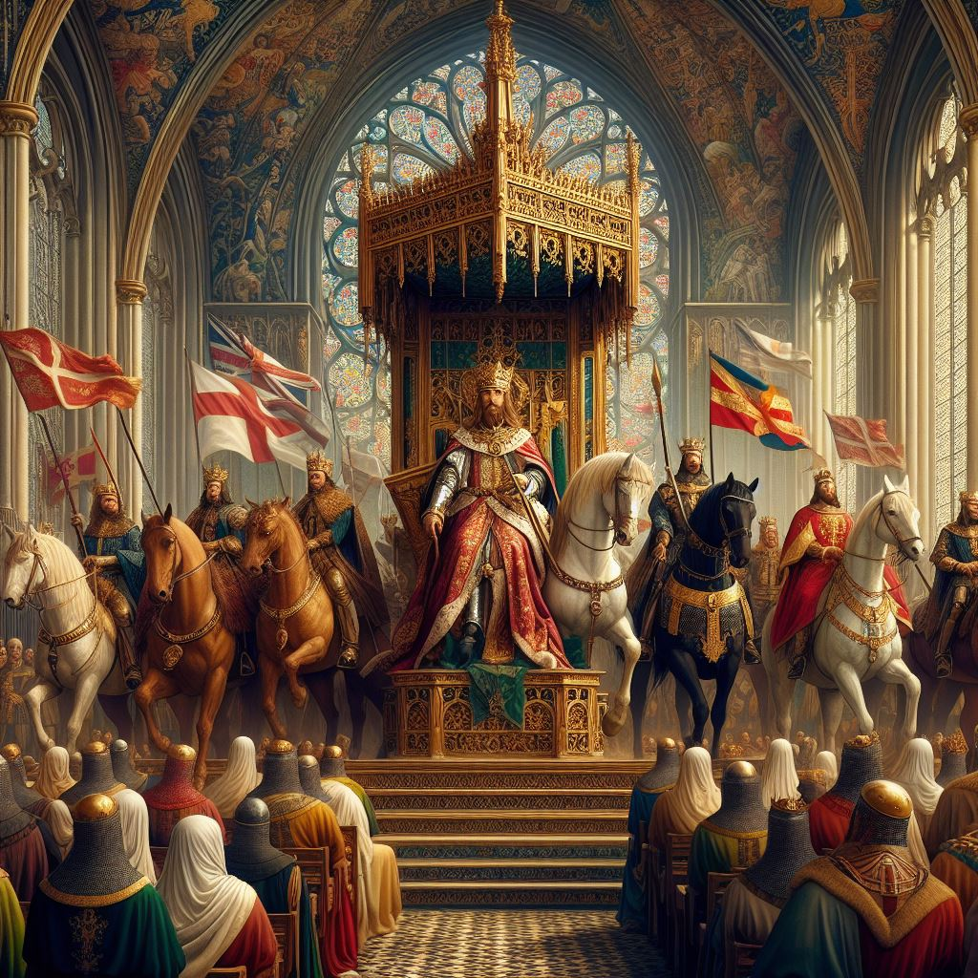
The origin of Direct Democrazy - The monarchy system
The monarchy was widely adopted as the main political system in medieval continental Europe, as well as in England.

Slide 3
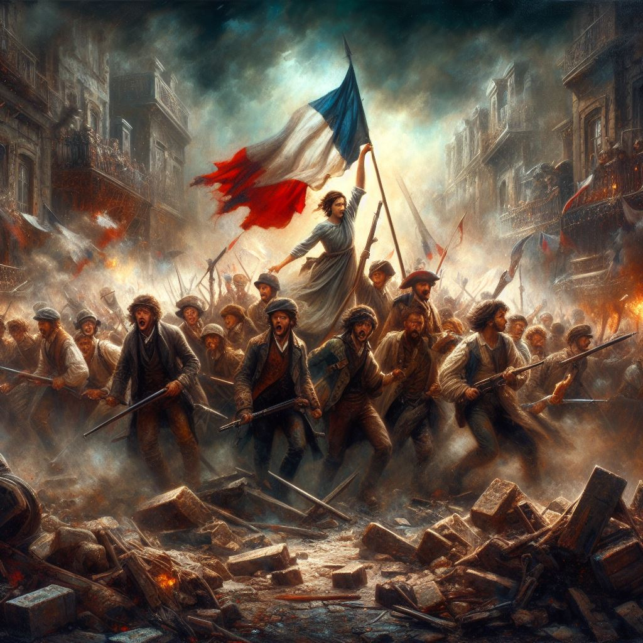
The origin of Direct Democrazy - The monarchy system
But as a feudal rule, with its appeal to divine right and force, made the monarch the sole performer on the political stage.

Slide 4
The Rise Of Democracy
Along with the Age of Enlightenment, there was an awakening of a sense of natural rights(John Locke), and people were not content to be audience of politics, but to actually participate in politics on an equal and free basis.

Slide 5
The Rise Of Democracy
As a result, people overthrew the monarchy state and established the political of representative democracy or direct democracy.

Slide 6
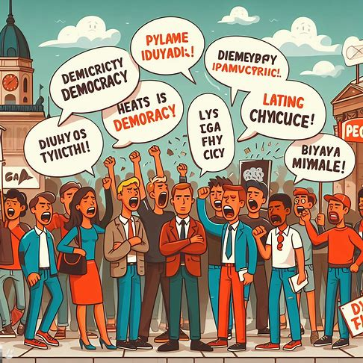
But democracy has its price.
Majority rule has the potential to become the tyranny of the majority.
The tyranny of the majority brings with it the oppression of minority rights by the majority ——— Jacobin rule of terror（雅各宾专政）

Slide 7
Thus, democracy needs to evolve

Slide 8
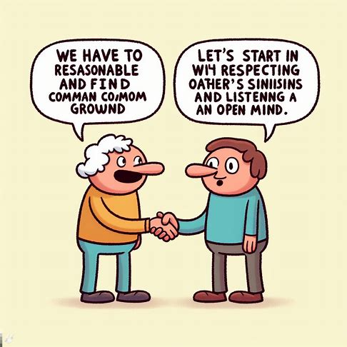
Deliberative democracy emerges
In direct democrazy, it is easy for people to see votes and voting as the core of a democratic society, ignoring the fact that participation and discussion of public affairs, listening to the ideas of different citizens and making the best decisions together is the most important spirit of democracy.

Slide 9
Deliberative democracy might be the solution.

Slide 10
Five principles of Deliberative democracy
Deliberative democracy has its normative aspects. According to Amy Gutmann and Dennis Thompson, the normative principles of deliberative democracy are:
the principle of mutuality
the principle of openness
the principle of fundamental freedoms
the principle of fundamental opportunities
the principle of fair opportunity.

Slide 11
The principle of mutuality
In the public life, one cannot just express what one believes, but one has to take into account others with different viewpoints, and even put aside the need to listen to what others think. However, since different ethnic groups have very different backgrounds, cultures, education, and lifestyles, their values are often too different from each other's, so they should try to find ways to minimise their differences and disagreements, so as to avoid too much conflict.

Slide 12
The principle of openness
Generally speaking, members participating in public deliberation will not only include the people, but also government officials, relevant business units, experts and academics, and so on. Particularly in respect of scientific and technological issues and economic issues involving professional knowledge, the information and justifications put forward by members must be open and transparent. Since everyone knows that the views they put forward are open and can be examined by anyone, they will be more careful in their thinking and judgement, and will minimise bias, blindness, hasty judgement or inappropriate views as far as possible.

Slide 13
The Superiority of Deliberative Democrazy
Deliberative democracy not only promotes dialogue among citizens, giving them the opportunity to correct their own misperceptions and misinformation, it also has the effect of brainstorming and self-transformation.

Slide 14
Examples
National Committee of the Chinese People's Political Consultative Conference

Slide 15
Conclusion
In this prentation, I explored the origin of democracy, the problems of democracy, and why the shift to deliberative democracy.
The significance of deliberative democracy lies in the fact that it allows citizens to participate directly in the discussion of public policies or issues, and promotes mutual communication and understanding, which is particularly important for a democratic and pluralistic society.

Slide 16
Conclusion
In this way, citizens can connect together, making our society stronger, inheriting our culture and developing our civilisation.

Slide 17
Thank you

